Slide 1
Computer Science 101
Boolean Algebra

Slide 2
What’s next?
A new type of algebra – Helps us
  With logical reasoning
  Understand circuits of a computer
The “innards” of a computer
  Basic circuits
  Major components and how they work together
  Low level instructions – machine language
  How data and instructions are stored in computer

Slide 3
George Boole
English mathematician
1815-1864
1854: Introduction to the Laws of Thought
Boolean algebra
  Logic
  Set Theory
  Circuits
  Programming: Conditions in “while” and “if”

Slide 4
Boolean Constants and Variables
In Boolean algebra, there are only two constants.
  True and False
  On and Off
  +5v and 0v
  1 and 0
Boolean variables are variables that store values that are Boolean constants.

Slide 5
Boolean Operator AND
If A and B are Boolean variables (or expressions) then
A AND B
is True (1) if and only if both A and B have values of True (1).
We denote the AND operation like multiplication in ordinary algebra:
AB or A.B

Slide 6
Boolean Operator OR
If A and B are Boolean variables (or expressions) then
A OR B
is True (1) if and only if at least one of A and B has value of True (1).
We denote the OR operation like addition in ordinary algebra:
A+B

Slide 7
Boolean Operator NOT
If A is a Boolean variable (or expression) then
NOT A
has the opposite value from A.
We denote the NOT operation by putting a bar over the variable (or expression) _
A

Slide 8
Boolean Expressions
As with ordinary algebra, a Boolean expression is a well-formed expression made from
  Boolean constants
  Boolean variables
  Operators AND, OR and NOT
  Parentheses
Example: _ ____
AB + (A+C)B

Slide 9
The value of a Boolean expression
At any point, the value of a BE can be computed using the current values of the variables.
Unlike ordinary algebra, for a BE, there are only finitely many possible assignments of values to the variables; so, theoretically, we can make a table, called a truth table that shows the value of the BE for every possible set of values of the variables.

Slide 10
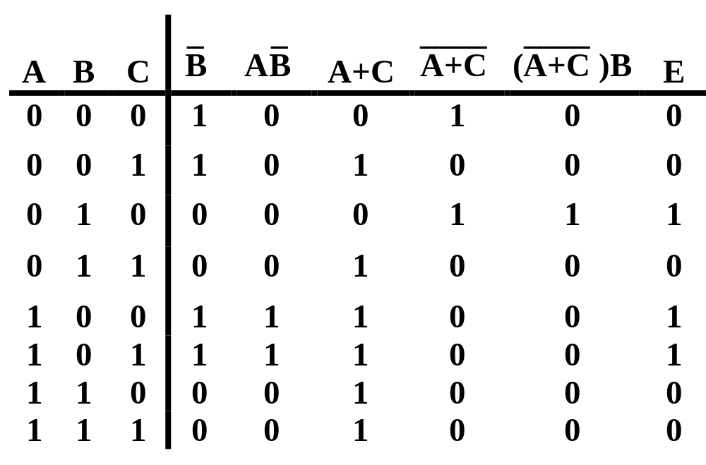
Truth Table: _ ____
E = AB + (A+C)B

Slide 11
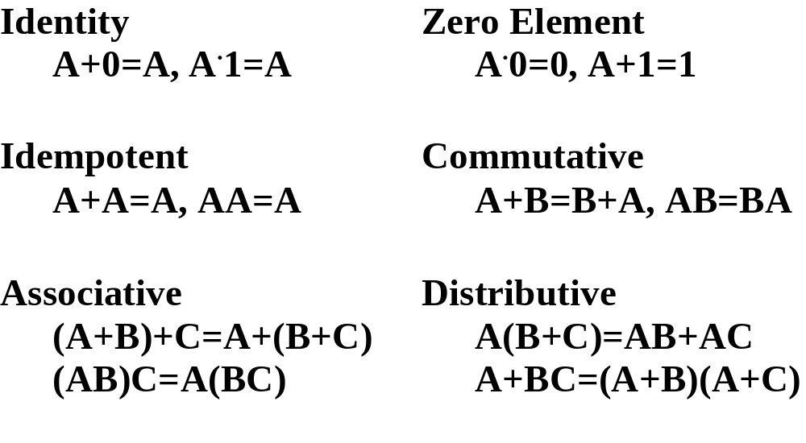
Laws of Boolean Algebra

Slide 12
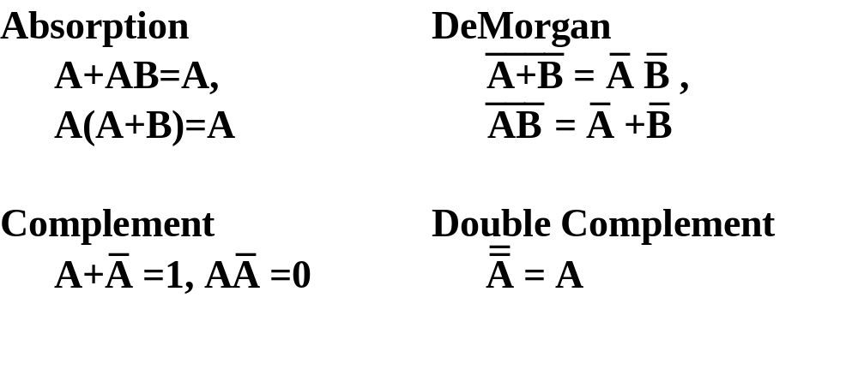
Laws of Boolean Algebra

Slide 13
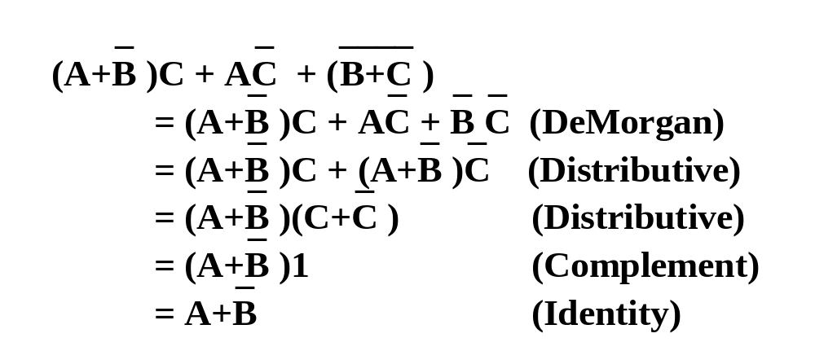
Boolean Expression Simplification

Slide 14
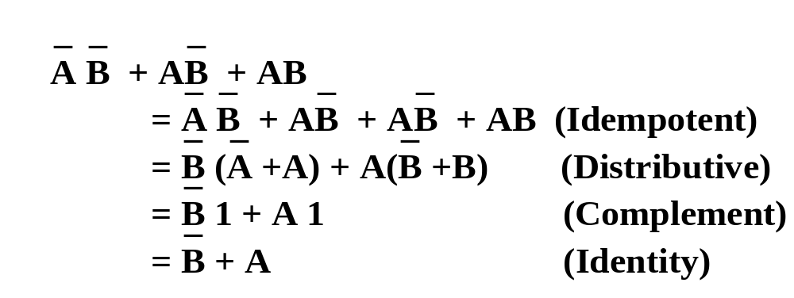
Boolean Expression Simplification

Slide 15

Quick Mate, close that gate!

